Slide 1
M8

Slide 2
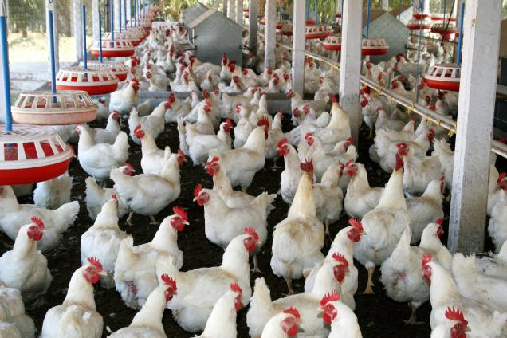
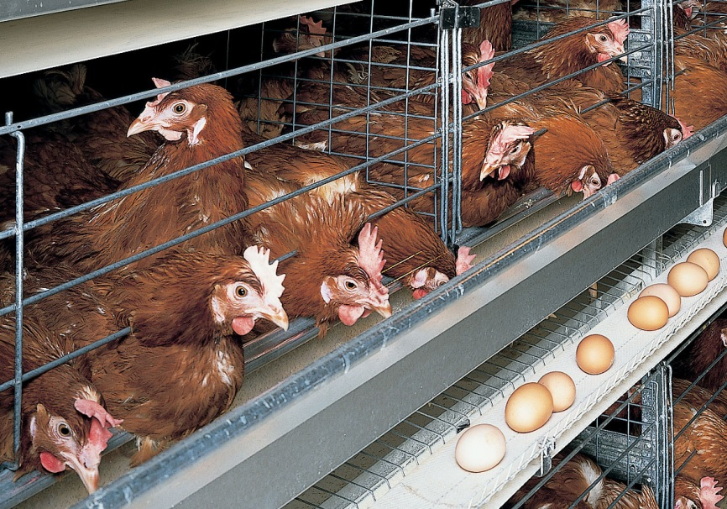
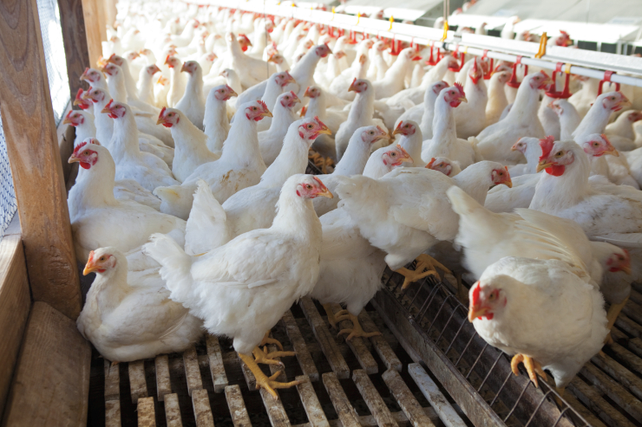
Poultry farming :
Poultry farming is undertaken to raise domestic fowl for egg production and chicken meat.
Two types of breeds are produced :
Layers for eggs
Broilers for meat

Slide 3
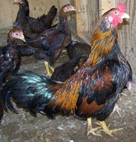
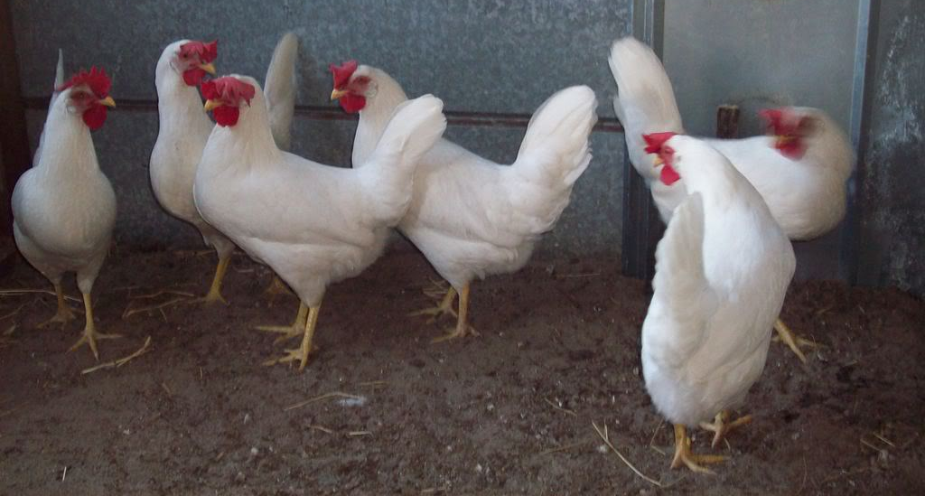
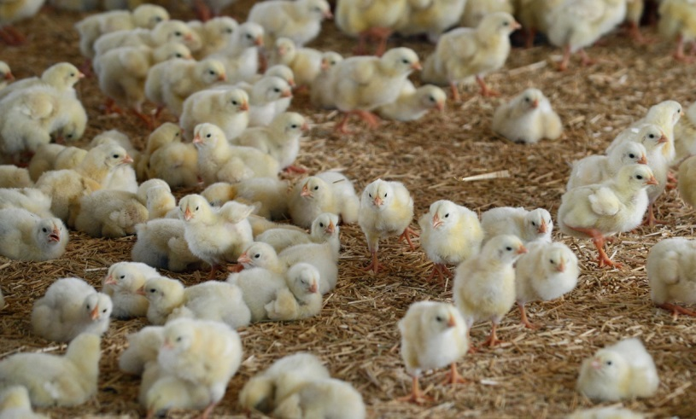
The cross-breeding programmes between
Indian : Indigenous, For example, Aseel. and
Foreign : Exotic, for example, Leghorn
breeds for variety improvement are focused on to develop new varieties for the following desirable traits
Number and quality of chicks
Dwarf broiler parent for commercial chick production
Summer adaptation capacity
Low maintenance requirements
Reduction in the size of the egg-laying bird with ability to utilise more fibrous cheaper diets formulated using agricultural by-products.
Tolerance to high temperature

Slide 4
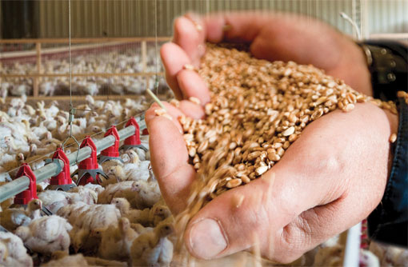
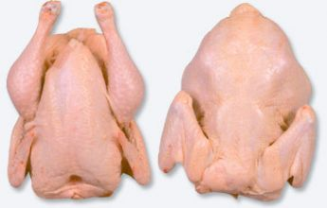
Egg and broiler production :
Broiler chickens are fed with vitamin-rich supplementary feed for good growth rate and better feed efficiency.
Care is taken to avoid mortality and to maintain feathering and carcass quality.
Death
They are produced as broilers and sent to market for meat purposes.
Dead body

Slide 5
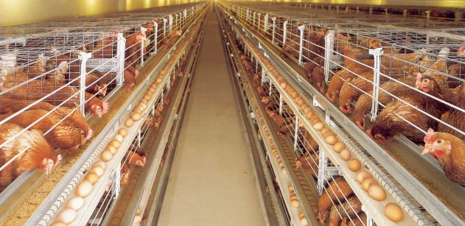
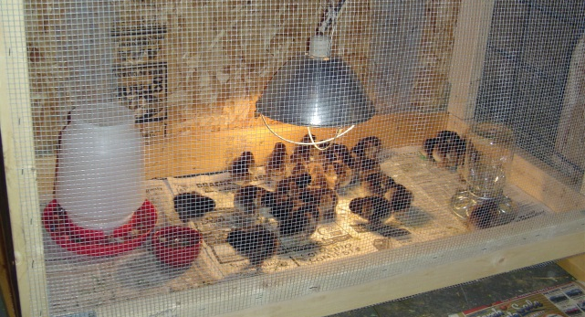
Egg and broiler production :
For good production of poultry birds, good management practices are important.
These include maintenance of temperature and hygienic conditions in housing and poultry feed, as well as prevention and control of diseases and pests.

Slide 6
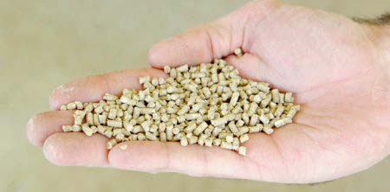
Egg and broiler production :
The housing, nutritional and environmental requirements of broilers are somewhat different from those of egg layers.
The ration (daily food requirement) for broilers is protein rich with adequate fat.
The level of vitamins A and K is kept high in the poultry feeds.

Slide 7
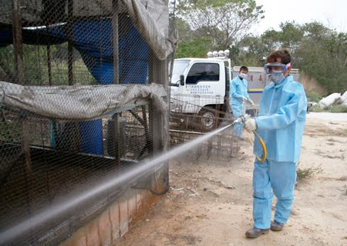
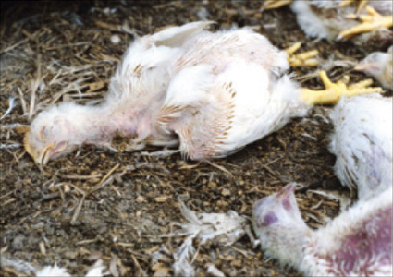
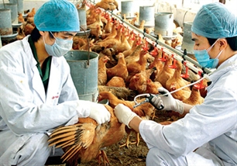
Egg and broiler production :
Poultry fowl suffer from a number of diseases caused by virus, bacteria, fungi, parasites, as well as from nutritional deficiencies.
These necessitate proper cleaning, sanitation, and spraying of disinfectants at regular intervals.
Appropriate vaccination can prevent the occurrence of infectious diseases and reduce loss of poultry during an outbreak of disease.

